Slide 1
实用测序数据分析 – 实验课 (3)
RNA-Seq数据分析
李国亮
2024年10月

Slide 2
目录
转录组介绍
转录组分析工具
转录组分析实验流程

Slide 3
转录组
转录组指某个物种或特定细胞在某一生理功能状态下，细胞内所有转录的RNA产物的集合
包含了时间和空间的限定
是连接基因组遗传信息与生物功能的蛋白质组的必然纽带
转录水平的调控是目前研究最多的，也是生物体最重要的调控方式

Slide 4
转录组的研究目的
定量基因的表达水平
鉴定新的转录本/基因
鉴定融合基因
鉴定选择性剪接
鉴定单核苷酸变异
鉴定RNA编辑
…

Slide 5
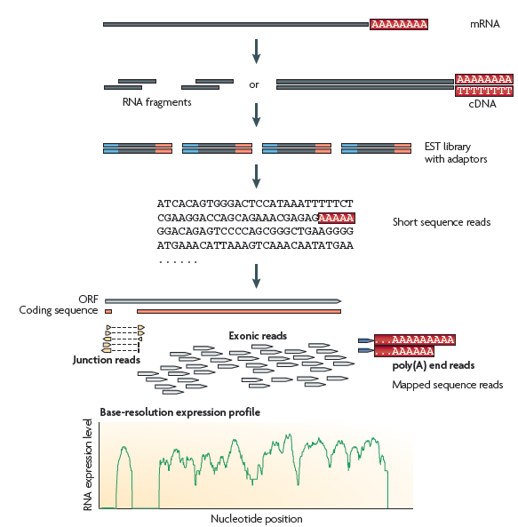
RNA-seq实验流程
A typical RNA-seq experiment. Briefly, long RNAs are first converted into a library of cDNA fragments through either RNA fragmentation or DNA fragmentation . Sequencing adaptors (blue) are subsequently added to each cDNA fragment and a short sequence is obtained from each cDNA using high-throughput sequencing technology. The resulting sequence reads are aligned
with the reference genome or transcriptome, and classified as three types: exonic reads, junction reads and poly(A) end-reads. A yeast ORF with one intron is shown. bottom - a base-resolution expression profile
Wang Z et al. Nat Rev Genet, 2009.

Slide 6
RNA-Seq测序数据分析流程
原始数据 FastQ文件
1.数据预处理
数据文件 FastQ文件
2.序列比对
mapping file
3.RNA-Seq数据分析
初步结果
4. GO analysis
进一步的结果

Slide 7
比较推荐的流程
Fastp -> HISAT2/STAR -> featureCounts -> DESeq2（基于gene Counts）
Fastp -> HISAT2/STAR -> StringTie -> EdgeR（基于转录本）
STAR/HISAT2比对
StringTie组装和计算FPKM
featureCounts进行基因水平计数
DESeq2/EdgeR计算差异表达

Slide 8
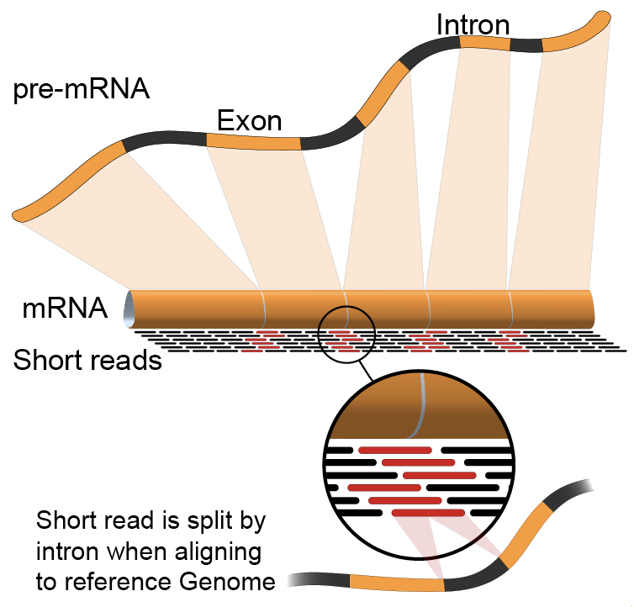
转录组比对的特点
不同于DNA序列比对的地方
https://baike.baidu.com/pic/RNA-seq/9420313?fromModule=pic

Slide 9
转录组比对工具-HISAT2
HISAT2 is a fast and sensitive alignment program for mapping next-generation sequencing reads (both DNA and RNA) to a population of human genomes as well as to a single reference genome. Based on an extension of BWT for graphs (Sirén et al. 2014), we designed and implemented a graph FM index (GFM), an original approach and its first implementation.
软件链接：https://daehwankimlab.github.io/hisat2/
Kim D et al. Nat Biotechnol, 2019.

Slide 10
转录组比对工具-STAR
STAR can discover non-canonical splices and chimeric (fusion) transcripts, and is also capable of mapping full-length RNA sequences. Using Roche 454 sequencing of reverse transcription polymerase chain reaction amplicons, we experimentally validated 1960 novel intergenic splice junctions with an 80-90% success rate, corroborating the high precision of the STAR mapping strategy.
软件链接：https://github.com/alexdobin/STAR
Dobin A et al. Bioinformatics, 2013.

Slide 11
基因表达定量工具-Stringtie
StringTie is a fast and highly efficient assembler of RNA-Seq alignments into potential transcripts. It uses a novel network flow algorithm as well as an optional de novo assembly step to assemble and quantitate full-length transcripts representing multiple splice variants for each gene locus. Its input can include not only the alignments of raw reads used by other transcript assemblers, but also alignments longer sequences that have been assembled from those reads. To identify differentially expressed genes between experiments, StringTie's output can be processed either by the Cuffdiff or Ballgown programs
软件链接：http://ccb.jhu.edu/software/stringtie/
Pertea M et al. Nat Biotechnol, 2015.

Slide 12
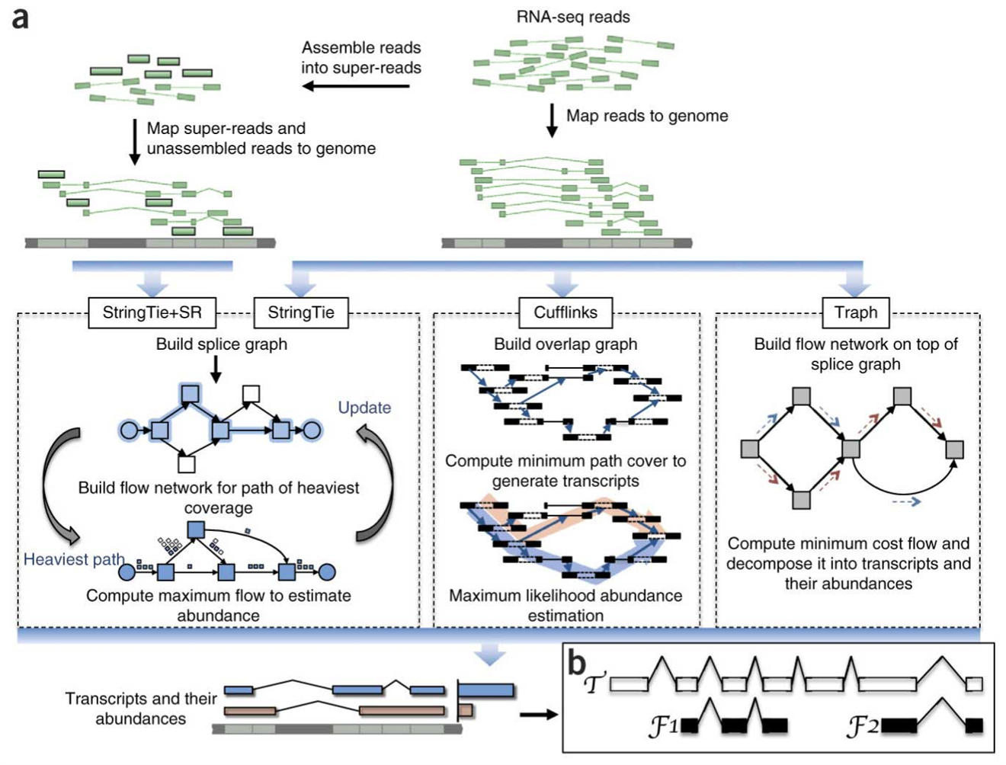
基因表达定量工具-Stringtie
Transcript assembly pipelines for StringTie, Cufflinks and Traph (Perte et al 2015)
Pertea M et al. Nat Biotechnol, 2015.

Slide 13
基因表达定量工具-featureCounts
featureCounts, a read summarization program suitable for counting reads generated from either RNA or genomic DNA sequencing experiments. featureCounts implements highly efficient chromosome hashing and feature blocking techniques. It is considerably faster than existing methods (by an order of magnitude for gene-level summarization) and requires far less computer memory. It works with either single or paired-end reads and provides a wide range of options appropriate for different sequencing applications.
软件链接：http://subread.sourceforge.net/
Liao Y et al. Bioinformatics, 2014.

Slide 14
差异表达分析工具-DESeq2
DESeq2, a method for differential analysis of count data, using shrinkage estimation for dispersions and fold changes to improve stability and interpretability of estimates. This enables a more quantitative analysis focused on the strength rather than the mere presence of differential expression.
软件链接：http://www.bioconductor.org/packages/release/bioc/html/DESeq2.html
Love MI et al. Genome Biol, 2014.

Slide 15
Software for RNA-Seq analysis
http://en.wikipedia.org/wiki/List_of_RNA-Seq_bioinformatics_tools
Mapping
  HISAT2 (http://daehwankimlab.github.io/hisat2/)
  STAR (https://github.com/alexdobin/STAR)
  Bowtie2/Tophat2 (https://ccb.jhu.edu/software/tophat/index.shtml)
  BWA (http://sourceforge.net/projects/bio-bwa/files/)
Transcriptome assembly
  StringTie(http://ccb.jhu.edu/software/stringtie/)
  Cufflinks (http://cufflinks.cbcb.umd.edu/ )
  Scripture (http://www.broadinstitute.org/software/scripture/ )
  Trinity (https://github.com/trinityrnaseq/trinityrnaseq/wiki )
Differential expression
  DEGseq (https://bioconductor.org/packages/release/bioc/vignettes/DEGseq/inst/doc/DEGseq.pdf)
  DESeq2 (http://bioconductor.org/packages/release/bioc/html/DESeq.html )
  EdgeR (http://www.bioconductor.org/packages/release/bioc/html/edgeR.html )
  Cufflinks/CuffDiff (http://cufflinks.cbcb.umd.edu/ )

Slide 16
实验所需材料
FastQ文件
参考基因组、基因组注释文件
数据预处理工具
转录组比对工具
基因定量工具
差异分析工具
基因富集工具
基因组浏览器IGV

Slide 17
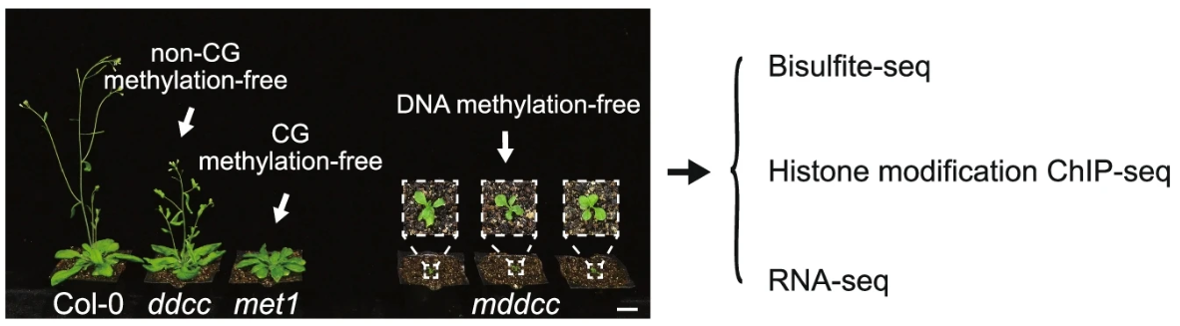
RNA-Seq数据
RNA-Seq数据来自拟南芥
  DNA methylation underpins the epigenomic landscape regulating genome transcription in Arabidopsis
  https://www.ncbi.nlm.nih.gov/bioproject/PRJNA762575
  数据说明：https://www.ncbi.nlm.nih.gov/geo/query/acc.cgi?acc=GSE183987
本实验选取Col-0与met1组的RNA-seq进行分析

Slide 18
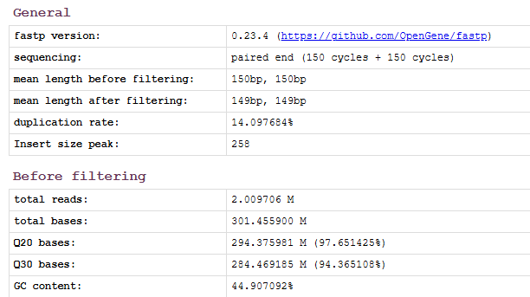
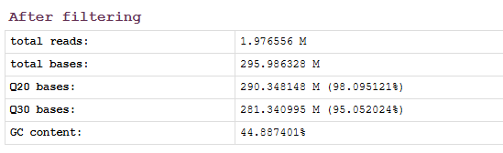
Fastp数据预处理（以Col_rep1样本为例）
mkdir Result/RNA-seq/QC_res
使用fastp默认参数进行数据预处理
./software/fastp/fastp -i dataset/Data/RNA-seq/Col_rep1.filter.R1.fastq.gz -o Result/RNA-seq/QC_res/Col_rep1.clean.R1.fastq.gz -I dataset/Data/RNA-seq/Col_rep1.filter.R2.fastq.gz -O Result/RNA-seq/QC_res/Col_rep1.clean.R2.fastq.gz -h Result/RNA-seq/QC_res/Col_rep1.fastp.html -j Result/RNA-seq/QC_res/Col_rep1.fastp.json --thread 16
Fastp预处理统计结果

Slide 19
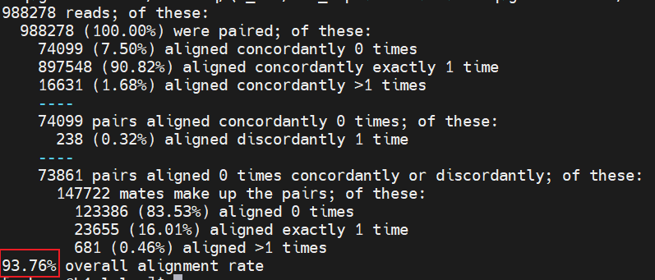
HISTA2 比对（以Col_rep1样本为例）
建立HISAT2 索引
mkdir dataset/Genome/hisat2_index
./software/hisat2-2.2.1/hisat2-build -p 20 dataset/Genome/arabidopsis_genome_chr1.fa dataset/Genome/hisat2_index/arabidopsis_genome_chr1
使用HISAT2进行RNA-seq比对
mkdir Result/RNA-seq/hisat2_result
./software/hisat2-2.2.1/hisat2 -x dataset/Genome/hisat2_index/arabidopsis_genome_chr1 -1 Result/RNA-seq/QC_res/Col_rep1.clean.R1.fastq.gz -2 Result/RNA-seq/QC_res/Col_rep1.clean.R2.fastq.gz -S Result/RNA-seq/hisat2_result/Col_rep1.sam -p 20
指定需比对的双端测序数据
Col_rep1样本的比对信息如下

Slide 20

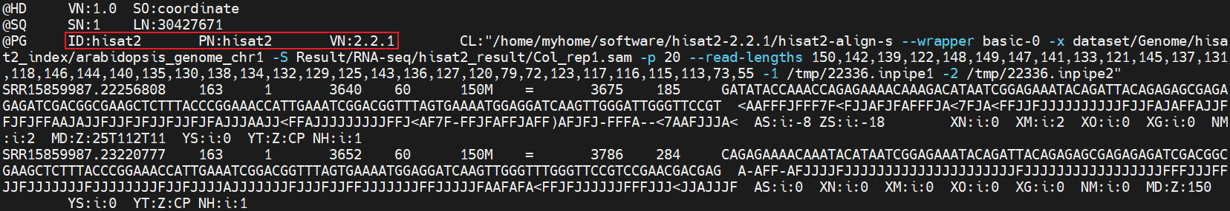
HISTA2 比对（以Col_rep1样本为例）
这些对比对后文件的操作，与比对工具的选择无关
sam 文件转 为bam文件，并删除 sam文件
samtools view -bS Result/RNA-seq/hisat2_result/Col_rep1.sam > Result/RNA-seq/hisat2_result/Col_rep1.bam && rm Result/RNA-seq/hisat2_result/Col_rep1.sam
生成排序bam文件，并删除原始bam文件
samtools sort Result/RNA-seq/hisat2_result/Col_rep1.bam -o Result/RNA-seq/hisat2_result/Col_rep1.sort.bam && rm Result/RNA-seq/hisat2_result/Col_rep1.bam
排序后的bam文件比原始bam文件要小是正常现象
相关资料可以查看：https://www.jianshu.com/p/6ed1bfbb7b72
为排序bam文件建立索引
samtools index Result/RNA-seq/hisat2_result/Col_rep1.sort.bam
查看比对结果
samtools view -h Result/RNA-seq/hisat2_result/Col_rep1.sort.bam | less

Slide 21
STAR 比对（以Col_rep1样本为例）
建立STAR索引
mkdir dataset/Genome/STAR_index
./software/STAR-2.7.11b/bin/Linux_x86_64_static/STAR --runThreadN 16 --runMode genomeGenerate --genomeDir dataset/Genome/STAR_index/ --genomeFastaFiles dataset/Genome/arabidopsis_genome_chr1.fa
使用STAR进行RNA-seq比对
mkdir Result/RNA-seq/STAR_result
./software/STAR-2.7.11b/bin/Linux_x86_64_static/STAR --runThreadN 16 --runMode alignReads --readFilesCommand zcat --outSAMunmapped None --genomeDir dataset/Genome/STAR_index/ --readFilesIn Result/RNA-seq/QC_res/Col_rep1.clean.R1.fastq.gz Result/RNA-seq/QC_res/Col_rep1.clean.R2.fastq.gz --outFileNamePrefix Result/RNA-seq/STAR_result/Col_rep1_
指定需比对的双端测序数据
STAR工具的使用教程可参考：https://www.jianshu.com/p/5b6dfc954315

Slide 22
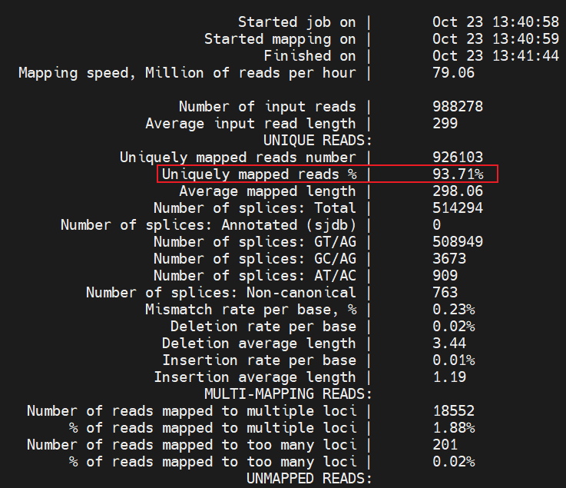
STAR 比对（以Col_rep1样本为例）
查看基本的比对统计信息
less Result/RNA-seq/STAR_result/Col_rep1_Log.final.out

Slide 23
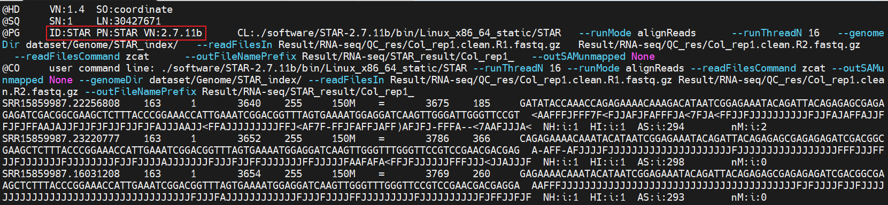
STAR 比对（以Col_rep1样本为例）
操作同前面介绍的HISAT2比对结果文件操作
sam 文件转 为bam文件，并删除 sam文件
samtools view -bS Result/RNA-seq/STAR_result/Col_rep1_Aligned.out.sam > Result/RNA-seq/STAR_result/Col_rep1.bam && rm Result/RNA-seq/STAR_result/Col_rep1_Aligned.out.sam
生成排序bam文件，并删除原始bam文件
samtools sort Result/RNA-seq/STAR_result/Col_rep1.bam -o Result/RNA-seq/STAR_result/Col_rep1.sort.bam && rm Result/RNA-seq/STAR_result/Col_rep1.bam
为排序bam文件建立索引
samtools index Result/RNA-seq/STAR_result/Col_rep1.sort.bam
查看比对结果
samtools view -h Result/RNA-seq/STAR_result/Col_rep1.sort.bam | less

Slide 24
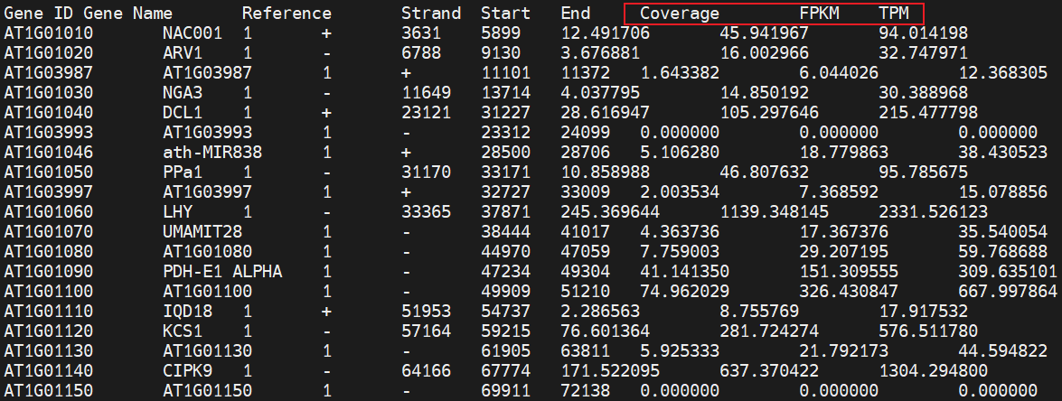
Stringtie确定基因表达量（以HISAT2比对Col_rep1为例）
mkdir Result/RNA-seq/stringtie_result
Stringtie进行转录本组装，并基于已有基因注释进行基因表达定量
./software/stringtie-2.2.3.Linux_x86_64/stringtie Result/RNA-seq/hisat2_result/Col_rep1.sort.bam -G dataset/Genome/Arabidopsis_thaliana.TAIR10.60.gtf -o Result/RNA-seq/stringtie_result/Col_rep1.gtf -e -A Result/RNA-seq/stringtie_result/Col_rep1.gene.tab
查看基因定量结果
less Result/RNA-seq/stringtie_result/Col_rep1.gene.tab
Stringtie的基因定量结果是标准化后的FPKM和TPM而不是Count

Slide 25

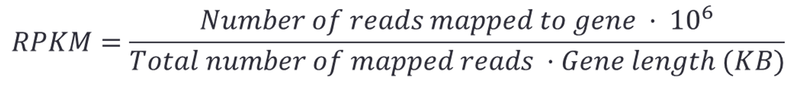
Gene expression levels from RNA-Seq
Count the reads mapped to individual genes
RPKM
  Reads Per Kilo-base of exon Per Million reads
归一化处理
针对不同的基因长度
归一化处理
针对不同的测序深度
Pair-end 1 Fragments = 2 Reads
FPKM = Fragments Per Kilobase per Million mapped reads

Slide 26
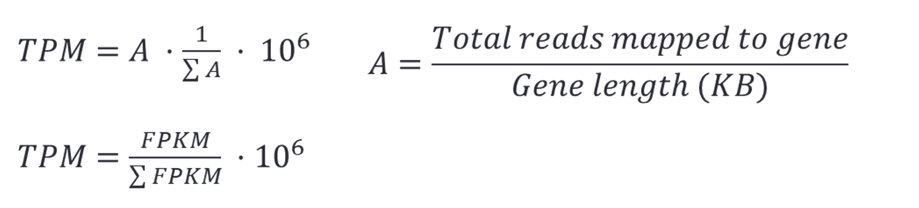
Gene expression levels from RNA-Seq
TPM : Transcripts per million
https://www.reneshbedre.com/blog/expression_units.html

Slide 27
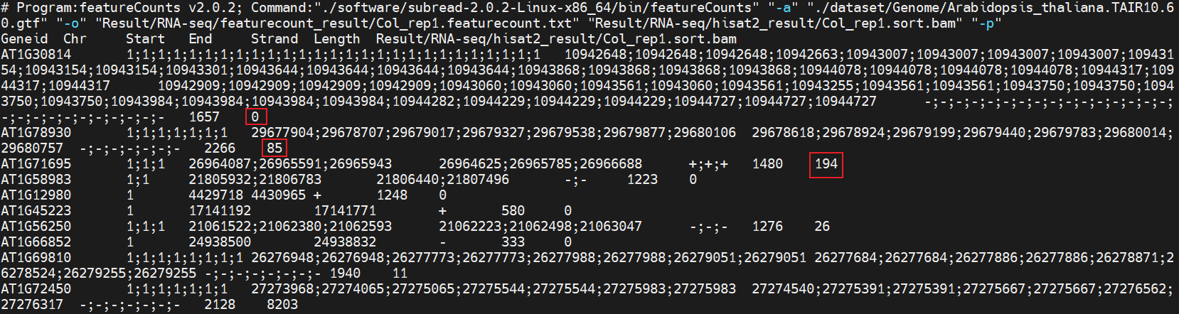
featureCounts确定基因表达量（以HISAT2比对Col_rep1为例）
mkdir Result/RNA-seq/featurecount_result
featureCounts基于已有基因注释进行基因表达定量
./software/subread-2.0.2-Linux-x86_64/bin/featureCounts -a ./dataset/Genome/Arabidopsis_thaliana.TAIR10.60.gtf -o Result/RNA-seq/featurecount_result/Col_rep1.featurecount.txt Result/RNA-seq/hisat2_result/Col_rep1.sort.bam -p
查看基因定量结果
less Result/RNA-seq/featurecount_result/Col_rep1.featurecount.txt
featureCounts的基因定量结果是原始的Count

Slide 28
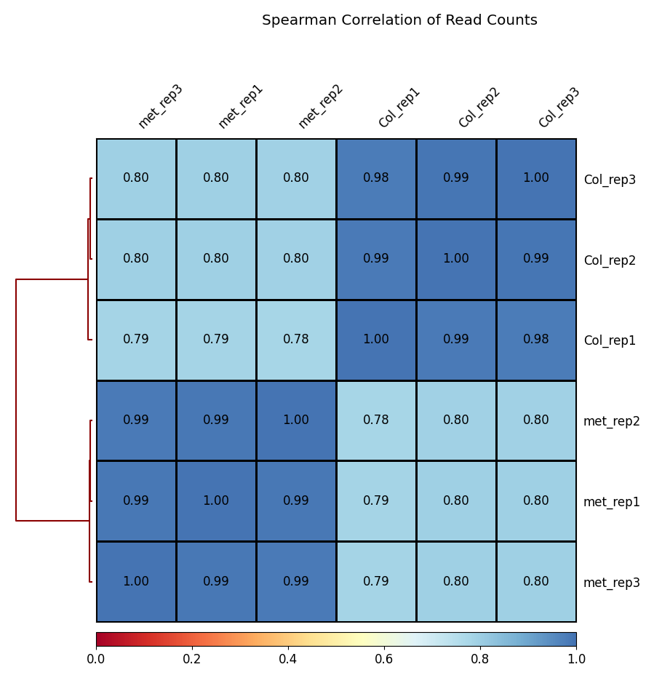
重复样本相关性
计算每个bam文件的覆盖度情况
multiBamSummary bins --bamfiles Result/RNA-seq/hisat2_result/Col_rep1.sort.bam Result/RNA-seq/hisat2_result/Col_rep2.sort.bam Result/RNA-seq/hisat2_result/Col_rep3.sort.bam Result/RNA-seq/hisat2_result/met1_rep1.sort.bam Result/RNA-seq/hisat2_result/met1_rep2.sort.bam Result/RNA-seq/hisat2_result/met1_rep3.sort.bam --minMappingQuality 30 --labels Col_rep1 Col_rep2 Col_rep3 met_rep1 met_rep2 met_rep3 -out Result/RNA-seq/readCounts.npz --outRawCounts Result/RNA-seq/readCounts.tab -p 20
基于覆盖度信息进行层次聚类
plotCorrelation -in Result/RNA-seq/readCounts.npz --corMethod spearman --skipZeros --plotTitle "Spearman Correlation of Read Counts" --whatToPlot heatmap --colorMap RdYlBu --plotNumbers -o Result/RNA-seq/heatmap_SpearmanCorr_readCounts.png --outFileCorMatrix Result/RNA-seq/SpearmanCorr_readCounts.tab

Slide 29
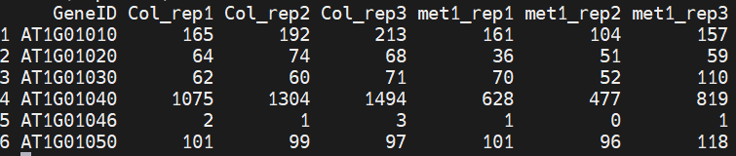
DESeq2差异分析（以hisat2比对featureCounts定量结果为例）
获取样本的表达矩阵
library(purrr)
samplelist <- c("Col_rep1", "Col_rep2", "Col_rep3", "met1_rep1", "met1_rep2", "met1_rep3")
读取不同样本的基因表达量列表
exprlist <- lapply(samplelist, function(x){
expr <- read.table(paste0("Result/RNA-seq/featurecount_result/", x, ".featurecount.txt"), header=T) ## 读取文件
expr<- expr[,c(1,7)] ### 提取基因id和表达量值
colnames(expr) <- c("GeneID", x) ## 重命名
expr
})
多个基因样本的基因表达量列表合并
expr.mat <- purrr::reduce(exprlist, function(x,y){merge(x,y, by="GeneID", all.x=T)})
合并后的表达矩阵如图所示

Slide 30
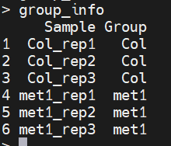
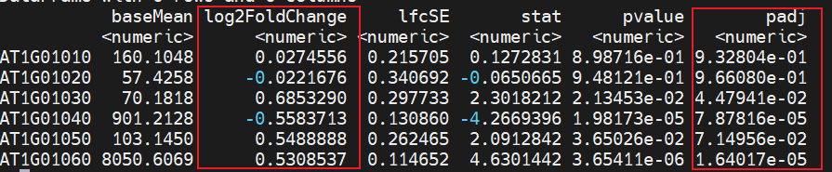
DESeq2差异分析（以hisat2比对featureCounts定量结果为例）
差异表达分析
group_info <- data.frame(Sample=samplelist, Group=c(rep("Col",3), rep("met1",3))) ## 生成样本分组
library(DESeq2)
library(ggplot2)
library(tibble)
expr <- column_to_rownames(expr.mat, "GeneID") # 表达矩阵
colData <- group_info # 分组信息
colData$Group <- factor(colData$Group, levels = c("Col", "met1"))
dds <- DESeqDataSetFromMatrix(countData = as.matrix(expr), colData = colData, design = ~Group)
dds <- dds[rowSums(counts(dds)) > 10, ] # 过滤低表达基因
dds <- DESeq(dds) # 差异分析
resultsNames(dds) # 查看比较组别
res <- results(dds) # 获取差异表达结果
head(res) # 查看差异表达结果
## 保存分析结果
write.csv(res, "./deseq2.diff.csv")

Slide 31
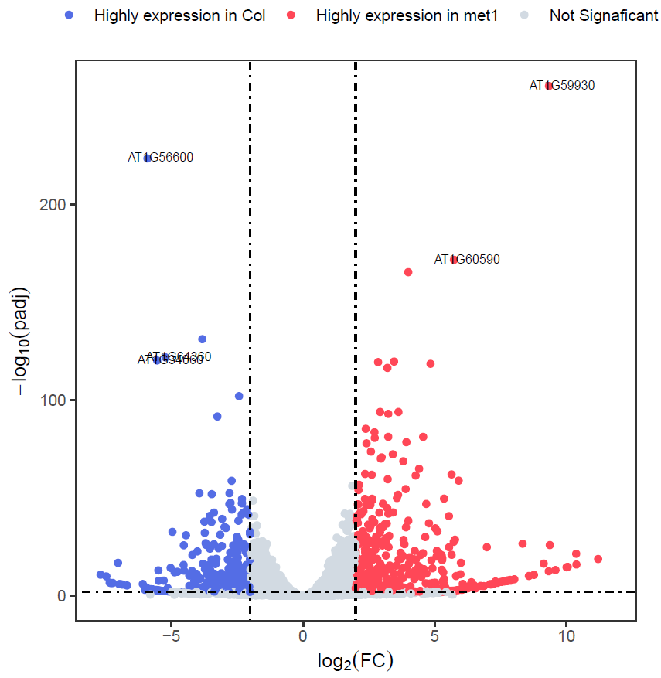
DESeq2差异分析（以hisat2比对featureCounts定量结果为例）
火山图绘制
res.plot <- data.frame(res, stringsAsFactors = FALSE, check.names = FALSE)
res.plot <- na.omit(res.plot)
res.plot$gene <- rownames(res.plot)
res.plot$sig <- "Not Signaficant"
res.plot[res.plot$log2FoldChange > 2 & res.plot$padj < 0.01, ]$sig <- "Highly expression in met1"
res.plot[res.plot$log2FoldChange < -2 & res.plot$padj < 0.01, ]$sig <- "Highly expression in Col"
res.plot$label <- ifelse(res.plot$padj < 10e-100 & abs(res.plot$log2FoldChange) >= 5,
rownames(res.plot), "")
p <- ggplot(data=res.plot, aes(x=log2FoldChange,y= -log10(padj))) +
geom_point(aes(color=sig)) +
geom_text(aes(label=label), nudge_x=.5,nudge_y=.5, size=2.5) +
scale_color_manual(values=c("#546de5", "#ff4757", "#d2dae2")) +
labs(x=expression(log[2](FC)), y=expression(-log[10](padj))) +
geom_hline(yintercept=2, linetype=4) +
geom_vline(xintercept=c(-2, 2),linetype=4) +
theme_bw() + theme(panel.grid = element_blank(),
legend.position = "top", legend.title = element_blank(), aspect.ratio=1,
legend.background = element_blank())
## 保存
ggsave("./Volcano.plot.pdf", p, width=5.5, height=5.5)

Slide 32
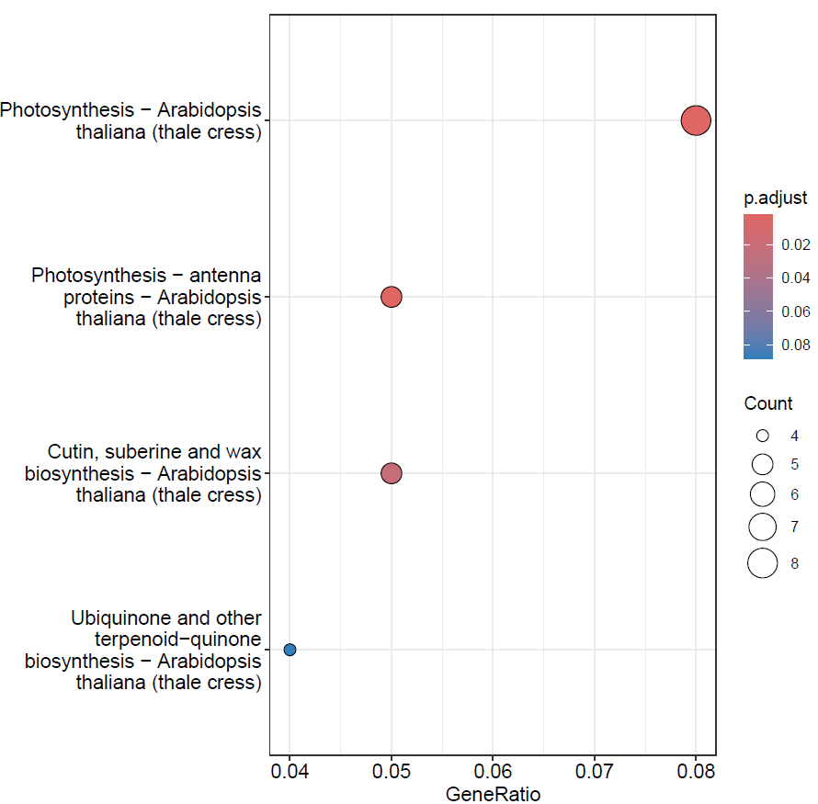
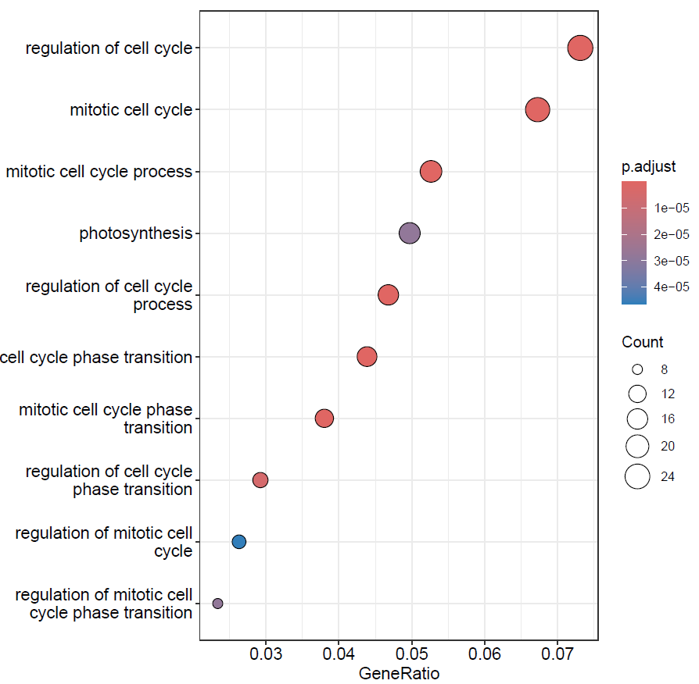
基因富集分析
met1高表达基因富集的KEGG通路
library(clusterProfiler)
获取差异表达基因
met1.high <- res.plot[res.plot$log2FoldChange > 2 & res.plot$padj < 0.01, "gene"]
col.high <- res.plot[res.plot$log2FoldChange < -2 & res.plot$padj < 0.01, "gene"]
KEGG富集
kegg.met1 <- enrichKEGG(met1.high , organism="ath", pvalueCutoff=.1)
kegg.col <- enrichKEGG(col.high , organism="ath", pvalueCutoff=.1)
GO富集
go.bp.met1 <- enrichGO(met1.high , OrgDb = "org.At.tair.db", keyType="TAIR", ont="BP")
go.bp.col <- enrichGO(col.high , OrgDb = "org.At.tair.db", keyType="TAIR", ont="BP")
met1高表达基因富集的BP通路

Slide 33
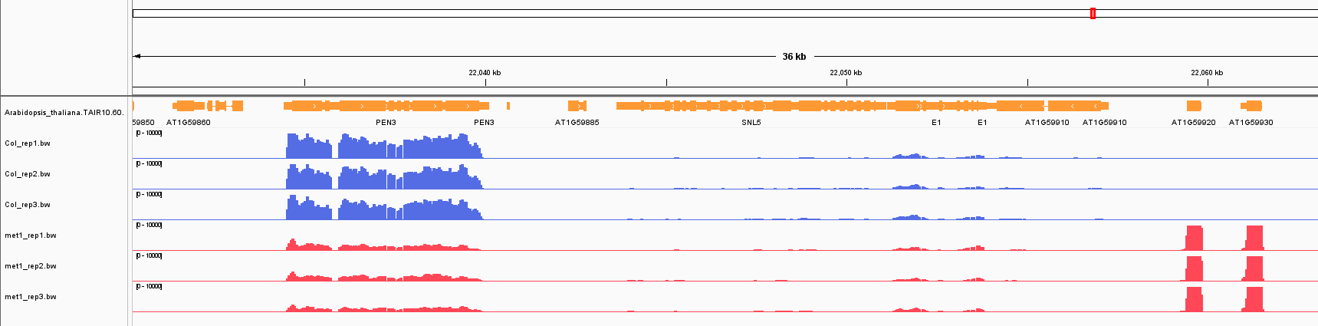
IGV可视化（以hisat2比对结果为例）
将比对文件转为bw文件用于IGV可视化
cd Result/RNA-seq/hisat2_result/
bamCoverage -b Col_rep1.sort.bam -o Col_rep1.bw --normalizeUsing RPKM -p 20
bamCoverage -b Col_rep2.sort.bam -o Col_rep2.bw --normalizeUsing RPKM -p 20
bamCoverage -b Col_rep3.sort.bam -o Col_rep3.bw --normalizeUsing RPKM -p 20
bamCoverage -b met1_rep1.sort.bam -o met1_rep1.bw --normalizeUsing RPKM -p 20
bamCoverage -b met1_rep2.sort.bam -o met1_rep2.bw --normalizeUsing RPKM -p 20
bamCoverage -b met1_rep3.sort.bam -o met1_rep3.bw --normalizeUsing RPKM -p 20
Col组高表达
met1组高表达

Slide 34
知识点回顾
RNA-seq分析工具和处理流程
基因组注释文件格式与下载
基因表达定量原理
差异表达分析
基因功能注释和富集分析

Slide 35
参考文献
Wang Z, Gerstein M, Snyder M. RNA-Seq: a revolutionary tool for transcriptomics. Nat Rev Genet. 2009;10(1):57-63. doi:10.1038/nrg2484.
Kim D, Paggi JM, Park C, Bennett C, Salzberg SL. Graph-based genome alignment and genotyping with HISAT2 and HISAT-genotype. Nat Biotechnol. 2019;37(8):907-915. doi:10.1038/s41587-019-0201-4.
Dobin A, Davis CA, Schlesinger F, et al. STAR: ultrafast universal RNA-seq aligner. Bioinformatics. 2013;29(1):15-21. doi:10.1093/bioinformatics/bts635.
Pertea M, Pertea GM, Antonescu CM, Chang TC, Mendell JT, Salzberg SL. StringTie enables improved reconstruction of a transcriptome from RNA-seq reads. Nat Biotechnol. 2015;33(3):290-295. doi:10.1038/nbt.3122.
Liao Y, Smyth GK, Shi W. featureCounts: an efficient general purpose program for assigning sequence reads to genomic features. Bioinformatics. 2014;30(7):923-930. doi:10.1093/bioinformatics/btt656.
Li H, Handsaker B, Wysoker A, et al. The Sequence Alignment/Map format and SAMtools. Bioinformatics. 2009;25(16):2078-2079. doi:10.1093/bioinformatics/btp352.
Love MI, Huber W, Anders S. Moderated estimation of fold change and dispersion for RNA-seq data with DESeq2. Genome Biol. 2014;15(12):550. doi:10.1186/s13059-014-0550-8.

Slide 36

致谢
感谢孙元辉、陈星宇、王哲、王云龙、赖福明、张逸东、周强伟、朱志贤等课题组成员更新PPT，感谢课题组所有成员对PPT的建议

Slide 37
谢谢！

